Slide 1


The Data Science Lifecycle
02
PART I · FOUNDATIONS OF DATA
CHAPTER 2 · WEEK 1
Data Science — From Foundations to Intelligent Systems
LECTURER
Dr. Mustafa Hameed
THE ISLAMIA UNIVERSITY OF BAHAWALPUR
Bahawalpur, Pakistan
Department of Information Technology · BSIT · Fall 2026
Notes:
Chapter 2: The Data Science Lifecycle. Part 1 — Foundations of Data. Week 1: The landscape and the lifecycle. Handout pages 11–16.

Slide 2

Where this chapter sits
THE COURSE
PART I
PART II
PART III
PART IV
PART V
PART VI
1
2
3
4
5
6
7
8
9
10
11
12
13
14
15
16
17
18
19
20
21
22
23
24
25
26
27
28
29
30
31
32
The Data Science Lifecycle
BUILDS ON
USED LATER IN
Ch 1 The Data Science Landscape
Ch 3 Data: Types, Sources and Quality
Ch 7 Acquisition, Wrangling and Cleaning
Ch 30 Managing Data Science Projects
Data Science · Chapter 2 · The Data Science Lifecycle
Handout p. 11 2
Notes:
Place the chapter. Before you start: Chapter 1 — particularly the four levels of analytics, which determine which lifecycle phases a project will need.

Slide 3

What you will be able to do
LEARNING OUTCOMES
By the end of this chapter you will be able to:
1
Describe the six phases of the CRISP-DM lifecycle and explain why the process is a loop rather than a line.
2
Translate a vague business request into a precise, measurable data science problem statement.
3
Distinguish a business metric from a model metric, and explain why a project needs both.
4
Estimate where project effort actually goes, and plan accordingly.
5
Recognise the four failure modes that kill data science projects before any model is fitted.
Data Science · Chapter 2 · The Data Science Lifecycle
Handout p. 11 3
Notes:
Read these out: they are the chapter's contract with the room. Each click adds one.

Slide 4

Vocabulary for this chapter
KEY TERMS
CRISP-DM
problem framing
business understanding
data understanding
baseline
business metric
model metric
success criterion
deployment
iteration
Each term is defined where it first matters — not here.
Data Science · Chapter 2 · The Data Science Lifecycle
Handout p. 11 4
Notes:
Do not define these now; they arrive one at a time. This slide is for the students' notes. Terms: CRISP-DM; problem framing; business understanding; data understanding; baseline; business metric; model metric; success criterion; deployment; iteration.

Slide 5

In this chapter
IN THIS CHAPTER
2.1
Why a Lifecycle at All
p. 11 ›
2.2
CRISP-DM: The Standard Lifecycle
p. 11 ›
2.3
Framing the Problem
p. 13 ›
2.4
Two Kinds of Metric
p. 13 ›
2.5
Where the Time Actually Goes
p. 14 ›
Data Science · Chapter 2 · The Data Science Lifecycle
Handout pp. 11–16 5
Notes:
The route through the chapter. Each row is a link: click it to jump to that section in the slide show.

Slide 6

Why a Lifecycle at All
KEY IDEA
Beginners imagine data science as: get data, build model, done. Practitioners know it as a loop that revisits its own assumptions repeatedly, and in which the modelling step is usually the shortest.
The value of naming the phases is not bureaucracy. It is that each phase has a distinct failure mode, and being able to say “we are stuck in data understanding” is the first step to getting unstuck.
Data Science · Chapter 2 · The Data Science Lifecycle
§2.1 · Handout p. 11 6
Notes:
Say this in your own words first; the slide is the handout's wording.

Slide 7
CRISP-DM: The Standard Lifecycle
SECTION 2 OF 5
2.2
2.1 Why a Lifecycle at All
2.2 CRISP-DM: The Standard Lifecycle
2.3 Framing the Problem
2.4 Two Kinds of Metric
2.5 Where the Time Actually Goes
Data Science · Chapter 2
Handout §2.2 7
Notes:
Pause. Name the question this section answers.

Slide 8

CRISP-DM
DEFINITION
The Cross-Industry Standard Process for Data Mining: a six-phase, explicitly cyclic process model — business understanding, data understanding, data preparation, modelling, evaluation and deployment. It remains the most widely taught lifecycle because it puts understanding the problem before touching the data.
Data Science · Chapter 2 · The Data Science Lifecycle
§2.2 · Handout p. 11 8
Notes:
Read the box aloud, then ask for an example from the room before moving on.

Slide 9
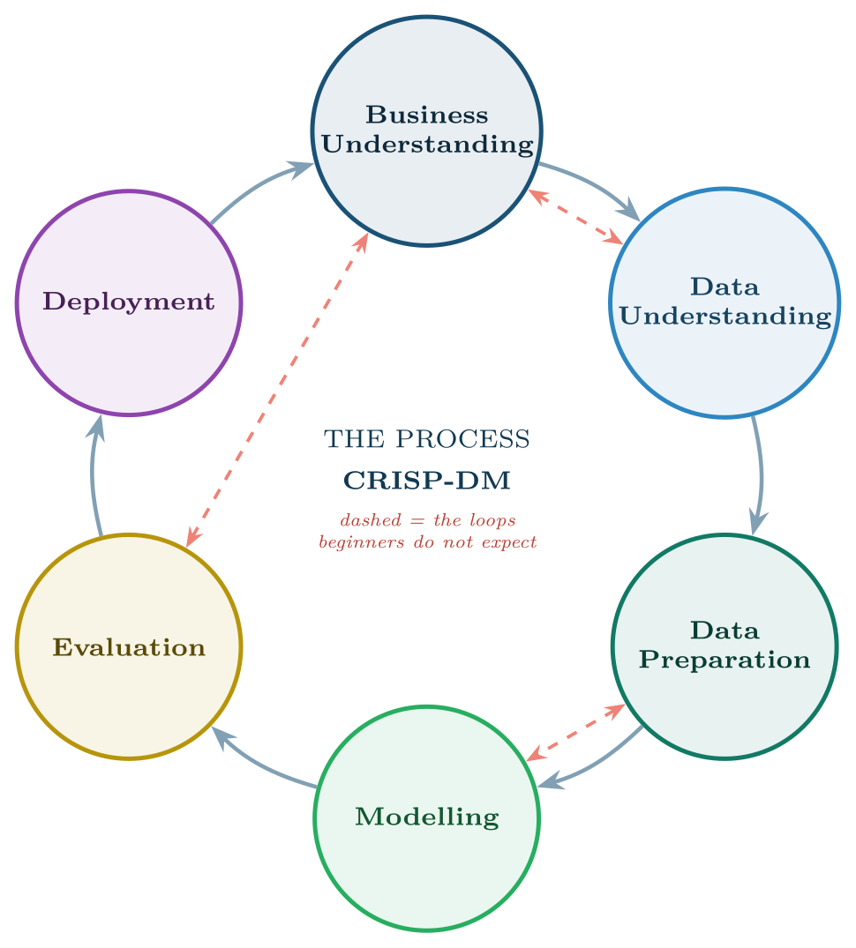
The CRISP-DM lifecycle
FIGURE 2.1
The solid arrows are the nominal order; the dashed arrows are the back-steps that happen in every real project. Evaluation sending you back to business understanding is not a sign of failure — it is the process working.
Data Science · Chapter 2 · The Data Science Lifecycle
§2.2 · Handout p. 11 9
Notes:
Figure 2.1 (handout p. 12): The CRISP-DM lifecycle. The solid arrows are the nominal order; the dashed arrows are the back-steps that happen in every real project. Evaluation sending you back to business understanding is not a sign of failure — it is the process working.

Slide 10

What Happens in Each Phase
AT A GLANCE
Phase | The work | Its characteristic failure
Business Understanding | Agree the objective, the decision it supports, the success criterion and the constraints | Building something nobody asked for, beautifully
Data Understanding | Collect, describe, explore and check the quality of what is available | Discovering in month three that the key field is 60% empty
Data Preparation | Clean, join, transform, engineer features, split the data | Leaking information from the future into the training set
Modelling | Select algorithms, train, tune hyperparameters | Chasing a 0.3% gain that the business cannot perceive
Evaluation | Check against the business criterion, not just the metric | Declaring victory on a test set that does not resemble reality
Deployment | Ship it, monitor it, retrain it, document it | Handing over a notebook and calling it a system
Data Science · Chapter 2 · The Data Science Lifecycle
§2.2.1 · Handout p. 11 10
Notes:
Do not read the table row by row: pick the row the room is most likely to get wrong and ask why.

Slide 11

Why Deployment Points Back to Business Understanding
CONCEPT
The arrow from deployment back to the start is the most important one in Figure 2.1. Once a model is live it changes the behaviour it was trained to predict — students who are warned study differently, attackers who are blocked change tactics. The world you modelled no longer exists, so the cycle restarts. Chapter 27 is entirely about living with this.
Data Science · Chapter 2 · The Data Science Lifecycle
§2.2.1 · Handout p. 11 11
Notes:
Read the box aloud, then ask for an example from the room before moving on.

Slide 12
Framing the Problem
SECTION 3 OF 5
2.3
2.1 Why a Lifecycle at All
2.2 CRISP-DM: The Standard Lifecycle
2.3 Framing the Problem
2.4 Two Kinds of Metric
2.5 Where the Time Actually Goes
Data Science · Chapter 2
Handout §2.3 12
Notes:
Pause. Name the question this section answers.

Slide 13
Problem Framing
DEFINITION
The act of converting a stakeholder’s goal into a precise specification: what is being predicted or described, for which unit of analysis, using what data available at what time, judged by what criterion, to support which decision.
Data Science · Chapter 2 · The Data Science Lifecycle
§2.3 · Handout p. 13 13
Notes:
Most projects that fail, fail here. A request arrives in the language of the business — “reduce dropouts”, “stop the breaches”, “ship on time” — and must be converted into something a computer can be scored against.

Slide 14
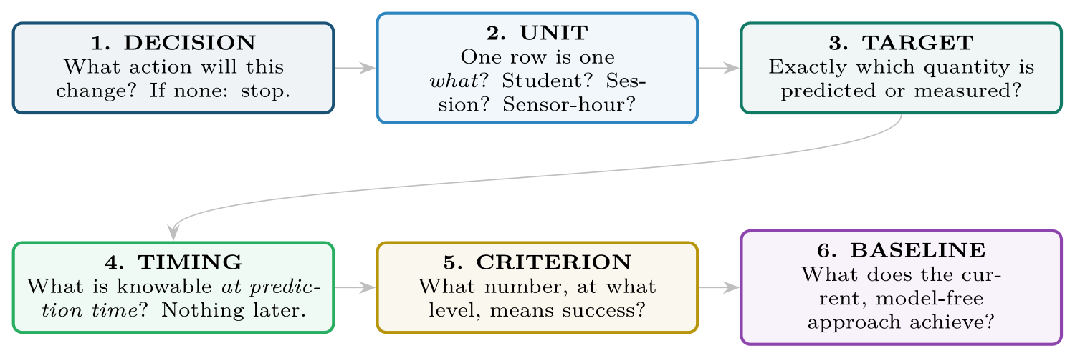
The six framing questions
FIGURE 2.2
Question 4 (timing) prevents the single most expensive mistake in applied machine learning — training on information that will not exist when the model is actually used. Question 6 stops you celebrating a model that is worse than a rule of thumb.
Data Science · Chapter 2 · The Data Science Lifecycle
§2.3 · Handout p. 13 14
Notes:
A complete frame answers six questions. If you cannot answer all six, you are not ready to open the data.
Figure 2.2 (handout p. 13): The six framing questions. Question 4 (timing) prevents the single most expensive mistake in applied machine learning — training on information that will not exist when the model is actually used. Question 6 stops you celebrating a model that is worse than a rule of thumb.

Slide 15

Question 4 Deserves Special Fear
WATCH OUT
A model that predicts student failure using final attendance percentage will look superb in testing and be useless in week 3, because final attendance is not known in week 3. This is called leakage, and it is treated in detail in Chapter 7 and Chapter 14. It has ruined more student projects than any other single error.
Data Science · Chapter 2 · The Data Science Lifecycle
§2.3 · Handout p. 13 15
Notes:
Read the box aloud, then ask for an example from the room before moving on.

Slide 16
Two Kinds of Metric
SECTION 4 OF 5
2.4
2.1 Why a Lifecycle at All
2.2 CRISP-DM: The Standard Lifecycle
2.3 Framing the Problem
2.4 Two Kinds of Metric
2.5 Where the Time Actually Goes
Data Science · Chapter 2
Handout §2.4 16
Notes:
Pause. Name the question this section answers.

Slide 17
Business Metric vs. Model Metric
DEFINITION
A model metric scores the model against the data (accuracy, error, AUC). A business metric scores the project against the world (dropouts prevented, downtime avoided, breaches caught, cost saved). A project needs both, and they can move in opposite directions.
Data Science · Chapter 2 · The Data Science Lifecycle
§2.4 · Handout p. 13 17
Notes:
Read the box aloud, then ask for an example from the room before moving on.

Slide 18

When a Better Model Is a Worse Project
WORKED EXAMPLE
A dropout-prediction model is improved from 88% to 91% accuracy. Is the project better off?
The data. 1,000 students, 100 of whom drop out. The department can fund 100 interventions.
Model A (88% accurate) flags 100 students, of whom 40 truly drop out — so 60 false alarms, and 60 leavers missed.
Model B (91% accurate) flags 26 students, of whom 18 truly drop out — 8 false alarms, and 82 leavers missed.
Model metric. B wins on accuracy: it makes fewer mistakes overall, largely by predicting “will not drop out” more often — which is right 90% of the time by default.
Business metric. Each successful intervention retains one student. Model A surfaces 40 real cases; Model B surfaces 18. Both fit inside the capacity of 100, so Model A retains up to 40 students and Model B up to 18.
Conclusion. Model A is worth roughly twice as much despite being the worse model by accuracy. The mismatch arises because accuracy ignores both the class imbalance and the capacity constraint. Chapter 14 builds the metrics that would have caught this — here, recall at a fixed budget.
Data Science · Chapter 2 · The Data Science Lifecycle
§2.4 · Handout p. 13 18
Notes:
Each click adds one step of the working. Ask for the next number before you reveal it.

Slide 19
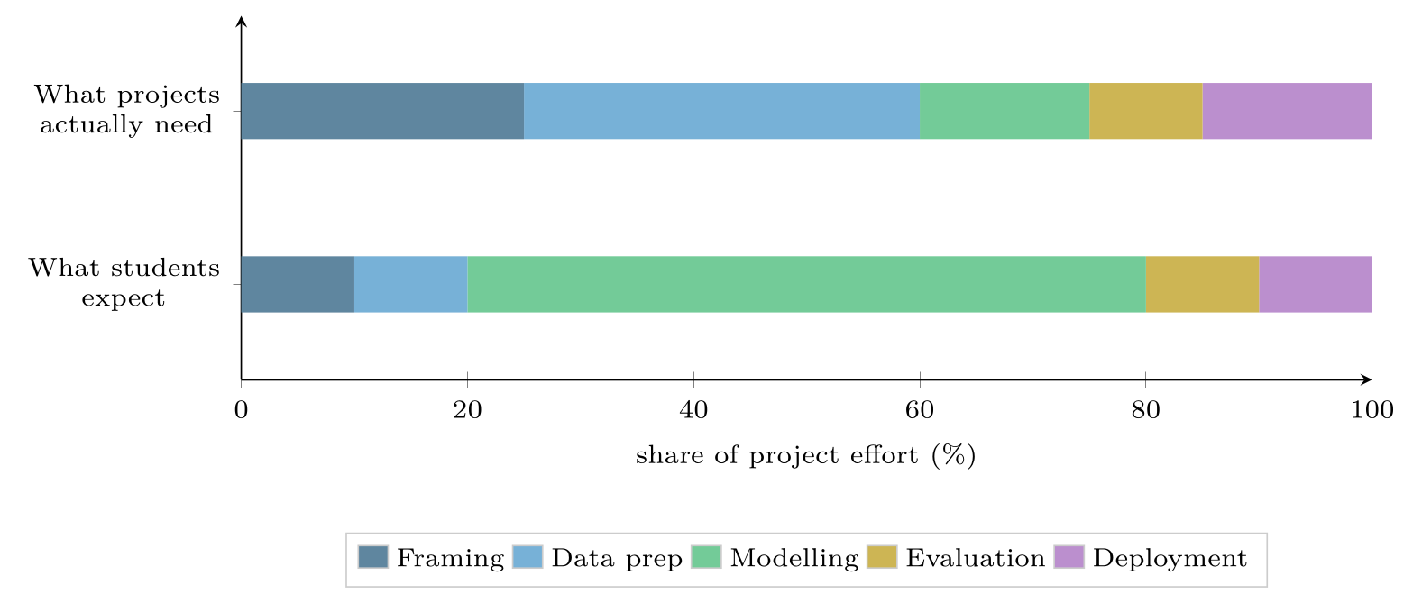
Expected versus actual effort
FIGURE 2.3
Modelling — the part that attracted you to the subject — is typically the smallest phase. Framing and data preparation together consume most of a real project, which is why Chapters 2, 3 and 7 exist.
Data Science · Chapter 2 · The Data Science Lifecycle
§2.5 · Handout p. 14 19
Notes:
Figure 2.3 (handout p. 14): Expected versus actual effort. Modelling — the part that attracted you to the subject — is typically the smallest phase. Framing and data preparation together consume most of a real project, which is why Chapters 2, 3 and 7 exist.

Slide 20

The Four Project Killers
COMMON PITFALLS
✕
No decision attached. If no action changes based on the output, the project cannot succeed, however accurate it is.
✕
No baseline. Without knowing what a simple rule achieves, you cannot show your model is worth its complexity.
✕
Unavailable-at-prediction-time features. See the alert above.
✕
A success criterion agreed only after seeing the results. If the target moves to wherever the model landed, the evaluation is theatre.
Data Science · Chapter 2 · The Data Science Lifecycle
§2.5 · Handout p. 14 20
Notes:
For each pitfall, ask who has seen it happen. One real story beats five bullets.

Slide 21





Four lenses: Problem Framing
FOUR LENSES
LEARNING ANALYTICS
PROJECT MANAGEMENT
Decision: which students receive an outreach call in week 5.
Decision: whether to add a developer to a sprint at the mid-point.
INTERNET OF THINGS
CYBERSECURITY
Decision: whether to schedule a motor for maintenance this week.
Decision: whether to force step-up authentication on a login.
Data Science · Chapter 2 · The Data Science Lifecycle
Handout p. 16 21
Notes:
The same method, four domains. Each of the next four slides opens one lens in full.

Slide 22

Learning Analytics: Problem Framing
FOUR LENSES
LEARNING ANALYTICS
Project Management
Decision: which students receive an outreach call in week 5. Unit: one enrolled student in one course-offering. Target: will the student withdraw or fail? Timing: only data from weeks 1–4 may be used. Criterion: catch at least 70% of eventual failures while flagging no more than 20% of the cohort, because staff can only call 20%. Baseline: flag everyone who missed two or more labs.
Internet of Things
Cybersecurity
Data Science · Chapter 2 · The Data Science Lifecycle
Handout p. 16 22
Notes:
Learning Analytics. Decision: which students receive an outreach call in week 5. Unit: one enrolled student in one course-offering. Target: will the student withdraw or fail? Timing: only data from weeks 1–4 may be used. Criterion: catch at least 70% of eventual failures while flagging no more than 20% of the cohort, because staff can only call 20%. Baseline: flag everyone who missed two or more labs.

Slide 23

Project Management: Problem Framing
FOUR LENSES
PROJECT MANAGEMENT
Learning Analytics
Decision: whether to add a developer to a sprint at the mid-point. Unit: one sprint for one team. Target: will committed story points be delivered? Timing: data up to day 5 of a 10-day sprint. Criterion: beat the scrum master’s own mid-sprint judgement, measured over 20 sprints. Baseline: “we finish if more than half the points are done by day 5.”
Internet of Things
Cybersecurity
Data Science · Chapter 2 · The Data Science Lifecycle
Handout p. 16 23
Notes:
Project Management. Decision: whether to add a developer to a sprint at the mid-point. Unit: one sprint for one team. Target: will committed story points be delivered? Timing: data up to day 5 of a 10-day sprint. Criterion: beat the scrum master’s own mid-sprint judgement, measured over 20 sprints. Baseline: “we finish if more than half the points are done by day 5.”

Slide 24

Internet of Things: Problem Framing
FOUR LENSES
INTERNET OF THINGS
Learning Analytics
Decision: whether to schedule a motor for maintenance this week. Unit: one motor on one day. Target: will it fail within 30 days? Timing: only telemetry up to and including today. Criterion: prevent at least 80% of unplanned failures with fewer than 5 unnecessary teardowns per 100 motors per year. Baseline: fixed-interval servicing every 90 days.
Project Management
Cybersecurity
Data Science · Chapter 2 · The Data Science Lifecycle
Handout p. 16 24
Notes:
Internet of Things. Decision: whether to schedule a motor for maintenance this week. Unit: one motor on one day. Target: will it fail within 30 days? Timing: only telemetry up to and including today. Criterion: prevent at least 80% of unplanned failures with fewer than 5 unnecessary teardowns per 100 motors per year. Baseline: fixed-interval servicing every 90 days.

Slide 25

Cybersecurity: Problem Framing
FOUR LENSES
CYBERSECURITY
Learning Analytics
Decision: whether to force step-up authentication on a login. Unit: one authentication attempt. Target: is this attempt an account takeover? Timing: only what is observable at the instant of the request. Criterion: detect 90% of takeovers while challenging under 1 in 500 legitimate logins — a false-positive budget set by the customer-experience team, not by the data scientist. Baseline: challenge every login from a new country.
Project Management
Internet of Things
Data Science · Chapter 2 · The Data Science Lifecycle
Handout p. 16 25
Notes:
Cybersecurity. Decision: whether to force step-up authentication on a login. Unit: one authentication attempt. Target: is this attempt an account takeover? Timing: only what is observable at the instant of the request. Criterion: detect 90% of takeovers while challenging under 1 in 500 legitimate logins — a false-positive budget set by the customer-experience team, not by the data scientist. Baseline: challenge every login from a new country.

Slide 26

Try it yourself: Writing a Frame
TRY IT YOURSELF
Take any dataset you have access to — your own module grades will do — and fill in this template before writing any analysis code. It takes ten minutes and saves days.
THIS WEEK'S LAB
WHAT YOU WILL RUN
Week 1: Meet a dataset; write a frame
1 listing, 12 lines of Python
Data Science · Chapter 2 · The Data Science Lifecycle
§2.5 · Handout p. 14 26
Notes:
Take any dataset you have access to — your own module grades will do — and fill in this template before writing any analysis code. It takes ten minutes and saves days.

Slide 27
Writing a Frame
LAB · STEP 1 OF 1
Set-up
Python
1
2
3
4
5
6
7
8
9
10
11
12
FRAME = {
"decision": "What action changes because of this output?",
"unit": "One row is one ______.",
"target": "Exactly what is predicted/measured, in what units?",
"timing": "Which columns exist at prediction time? List them.",
"criterion": "Success = ______ above/below ______.",
"baseline": "The no-model rule is ______, which achieves ______.",
}
for k, v in FRAME.items():
print(f"{k.upper():10s} {v}")
# Replace each value with your own answer, then re-read question 4.
Data Science · Chapter 2 · The Data Science Lifecycle
§2.5 · Handout p. 14 27
Notes:
Step 1: Set-up. Read the code aloud; ask what each line would print before running it.

Slide 28
What the lab shows
TRY IT YOURSELF
The test of a good frame: hand it to someone outside the project. If they can tell you what the model outputs and how you would know it worked, the frame is done.
Data Science · Chapter 2 · The Data Science Lifecycle
§2.5 · Handout p. 14 28
Notes:
Read the box aloud, then ask for an example from the room before moving on.

Slide 29

A team reports that model accuracy rose from 94% to 96% on a dataset where 95% of cases are negative. What should you ask before congratulating them?
CHECKPOINT 1 OF 3
Discuss with the person next to you, then advance.
Data Science · Chapter 2 · The Data Science Lifecycle
Handout p. 16 · answers in Appendix D 29
Notes:
Ask the room. Do not advance until someone commits to an answer.

Slide 30

A team reports that model accuracy rose from 94% to 96% on a dataset where 95% of cases are negative. What should you ask before congratulating them?
CHECKPOINT 1 OF 3 · ANSWER
What the majority-class baseline scores. If 95% of cases are negative, predicting “negative” always scores 95%, so 94% is worse than doing nothing and 96% is barely better. Ask for precision and recall.
Data Science · Chapter 2 · The Data Science Lifecycle
Handout p. 16 · answers in Appendix D 30
Notes:
Answer (Appendix D): What the majority-class baseline scores. If 95% of cases are negative, predicting “negative” always scores 95%, so 94% is worse than doing nothing and 96% is barely better. Ask for precision and recall.

Slide 31
Why does CRISP-DM draw an arrow from deployment back to business understanding, rather than ending at deployment?
CHECKPOINT 2 OF 3
Discuss with the person next to you, then advance.
Data Science · Chapter 2 · The Data Science Lifecycle
Handout p. 16 · answers in Appendix D 31
Notes:
Ask the room. Do not advance until someone commits to an answer.

Slide 32
Why does CRISP-DM draw an arrow from deployment back to business understanding, rather than ending at deployment?
CHECKPOINT 2 OF 3 · ANSWER
Because deployment changes the world the model was trained on: warned students behave differently, blocked attackers change tactics. The distribution shifts, so the cycle must restart (Chapter 27).
Data Science · Chapter 2 · The Data Science Lifecycle
Handout p. 16 · answers in Appendix D 32
Notes:
Answer (Appendix D): Because deployment changes the world the model was trained on: warned students behave differently, blocked attackers change tactics. The distribution shifts, so the cycle must restart (Chapter 27).

Slide 33
A hospital wants to predict which patients will be readmitted within 30 days. Name one feature that would be a leakage error, and say why.
CHECKPOINT 3 OF 3
Discuss with the person next to you, then advance.
Data Science · Chapter 2 · The Data Science Lifecycle
Handout p. 16 · answers in Appendix D 33
Notes:
Ask the room. Do not advance until someone commits to an answer.

Slide 34
A hospital wants to predict which patients will be readmitted within 30 days. Name one feature that would be a leakage error, and say why.
CHECKPOINT 3 OF 3 · ANSWER
Any feature recorded after or because of the readmission — for example days_to_readmission, or a discharge-summary field completed on re-entry. It will not exist at prediction time, so the model cannot use it in production.
Data Science · Chapter 2 · The Data Science Lifecycle
Handout p. 16 · answers in Appendix D 34
Notes:
Answer (Appendix D): Any feature recorded after or because of the readmission — for example days_to_readmission, or a discharge-summary field completed on re-entry. It will not exist at prediction time, so the model cannot use it in production.

Slide 35

What to take away
CHAPTER SUMMARY
1
CRISP-DM has six phases and is a loop; the back-steps are normal, not failures.
2
Framing precedes data. Answer all six framing questions — decision, unit, target, timing, criterion, baseline — before opening a file.
3
Timing (what is knowable at prediction time) prevents leakage, the most expensive routine mistake in the field.
4
Model metrics and business metrics are different and can disagree. A project is judged on the latter.
5
Modelling is the smallest phase. Framing and data preparation dominate.
Data Science · Chapter 2 · The Data Science Lifecycle
Handout p. 16 35
Notes:
Ask the room to say each takeaway before you reveal it.

Slide 36

Quick check 1 of 2
REVIEW · MULTIPLE CHOICE
In CRISP-DM, which phase immediately follows data preparation?
A
Evaluation
B
Modelling
C
Deployment
D
Business understanding
Data Science · Chapter 2 · The Data Science Lifecycle
Handout p. 16 36
Notes:
Take a show of hands for each option before discussing. (The handout does not print MCQ answers.)

Slide 37
Quick check 2 of 2
REVIEW · MULTIPLE CHOICE
A feature that would not be available when the model runs in production causes:
A
overfitting
B
leakage
C
underfitting
D
class imbalance
Data Science · Chapter 2 · The Data Science Lifecycle
Handout p. 16 37
Notes:
Take a show of hands for each option before discussing. (The handout does not print MCQ answers.)

Slide 38
For your notebook
REVIEW QUESTIONS
SHORT
Give a definition of “baseline” and explain in one sentence why a project without one cannot demonstrate value.
SHORT
Describe a situation in which a model with higher accuracy delivers lower business value than a model with lower accuracy.
SHORT
Why is “one row is one what?” a harder question than it appears for IoT telemetry?
APPLIED
Write a complete six-part frame for this request: “We want to use AI to stop our servers going down.”
APPLIED
For the learning analytics lens above, propose a different success criterion that would be appropriate if the department had unlimited staff, and explain how it changes which model you would prefer.
Data Science · Chapter 2 · The Data Science Lifecycle
Handout p. 16 38
Notes:
Set these for independent study. Model answers are not printed in the handout.

Slide 39
End of Chapter 2
02
NEXT
READ
Chapter 3 — Data: Types, Sources and Quality
Handout Chapter 2, pages 11–16
THIS WEEK'S LAB
Meet a dataset; write a frame
Data Science · Chapter 2 · The Data Science Lifecycle
39
Notes:
Close. NEXT: Chapter 3 — Data: Types, Sources and Quality. READ: Handout Chapter 2, pages 11–16. THIS WEEK'S LAB: Meet a dataset; write a frame.

